Slide 1
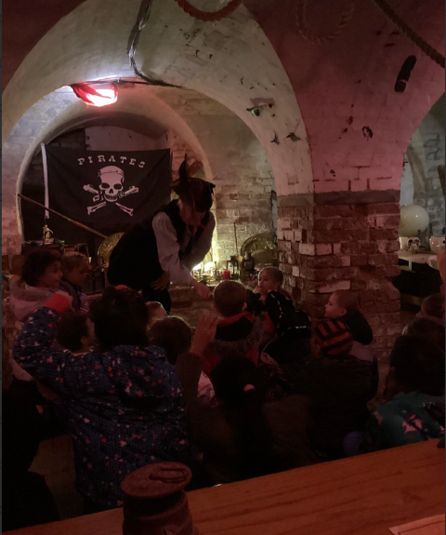
Class 2 Beaumanor Residential
Wed 5th Feb – Thurs 6th Feb 2024
Pirate Themed Fun!

Slide 2
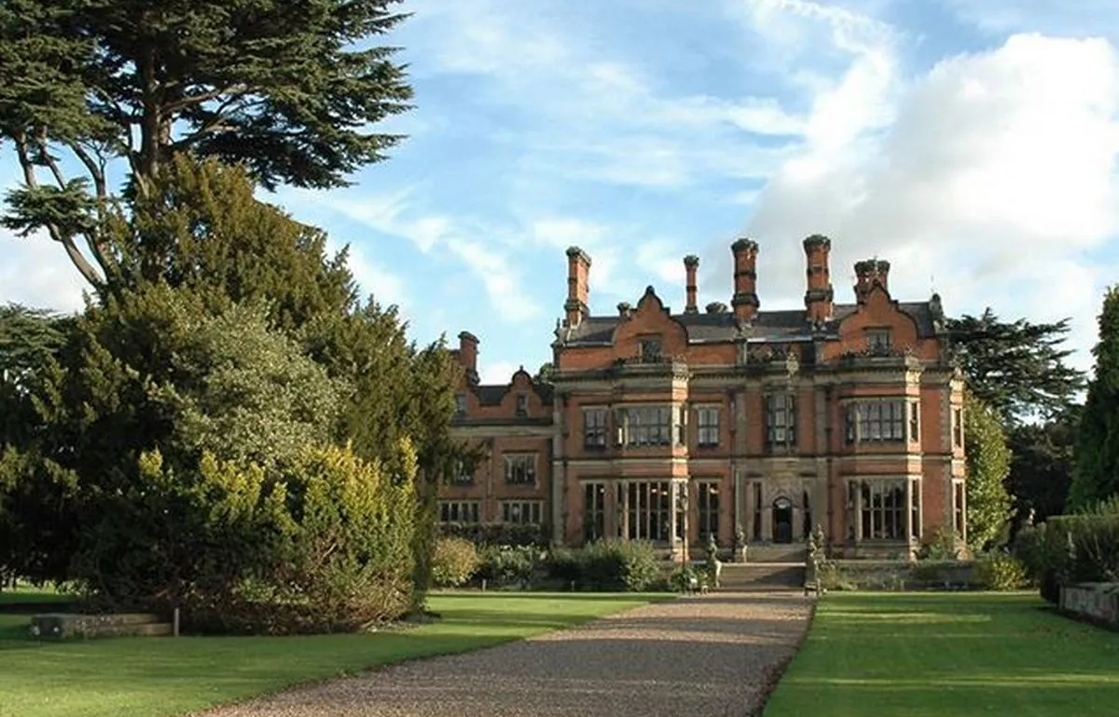
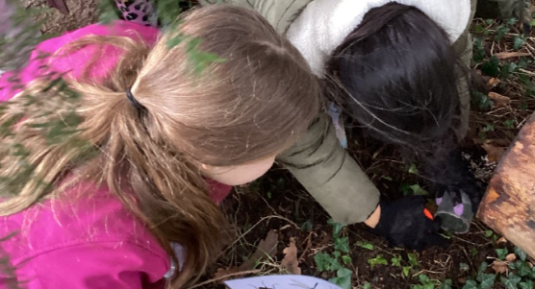
Beaumanor Hall
Outdoor Learning Centre
Beaumanor Drive,
Woodhouse,
Loughborough,
LE12 8TX
https://www.beaumanorhall.co.uk/schools-and-academies/

Slide 3
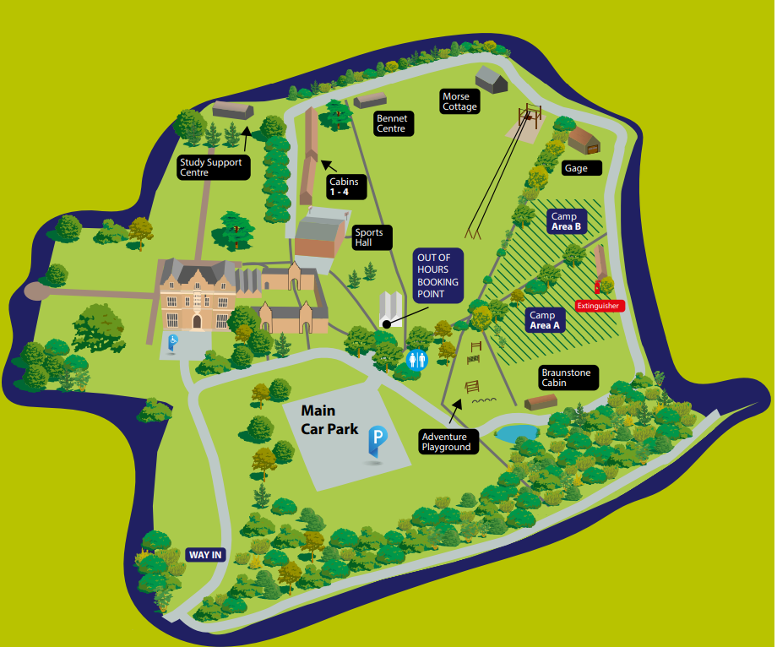

Slide 4
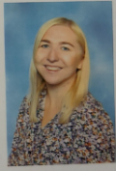
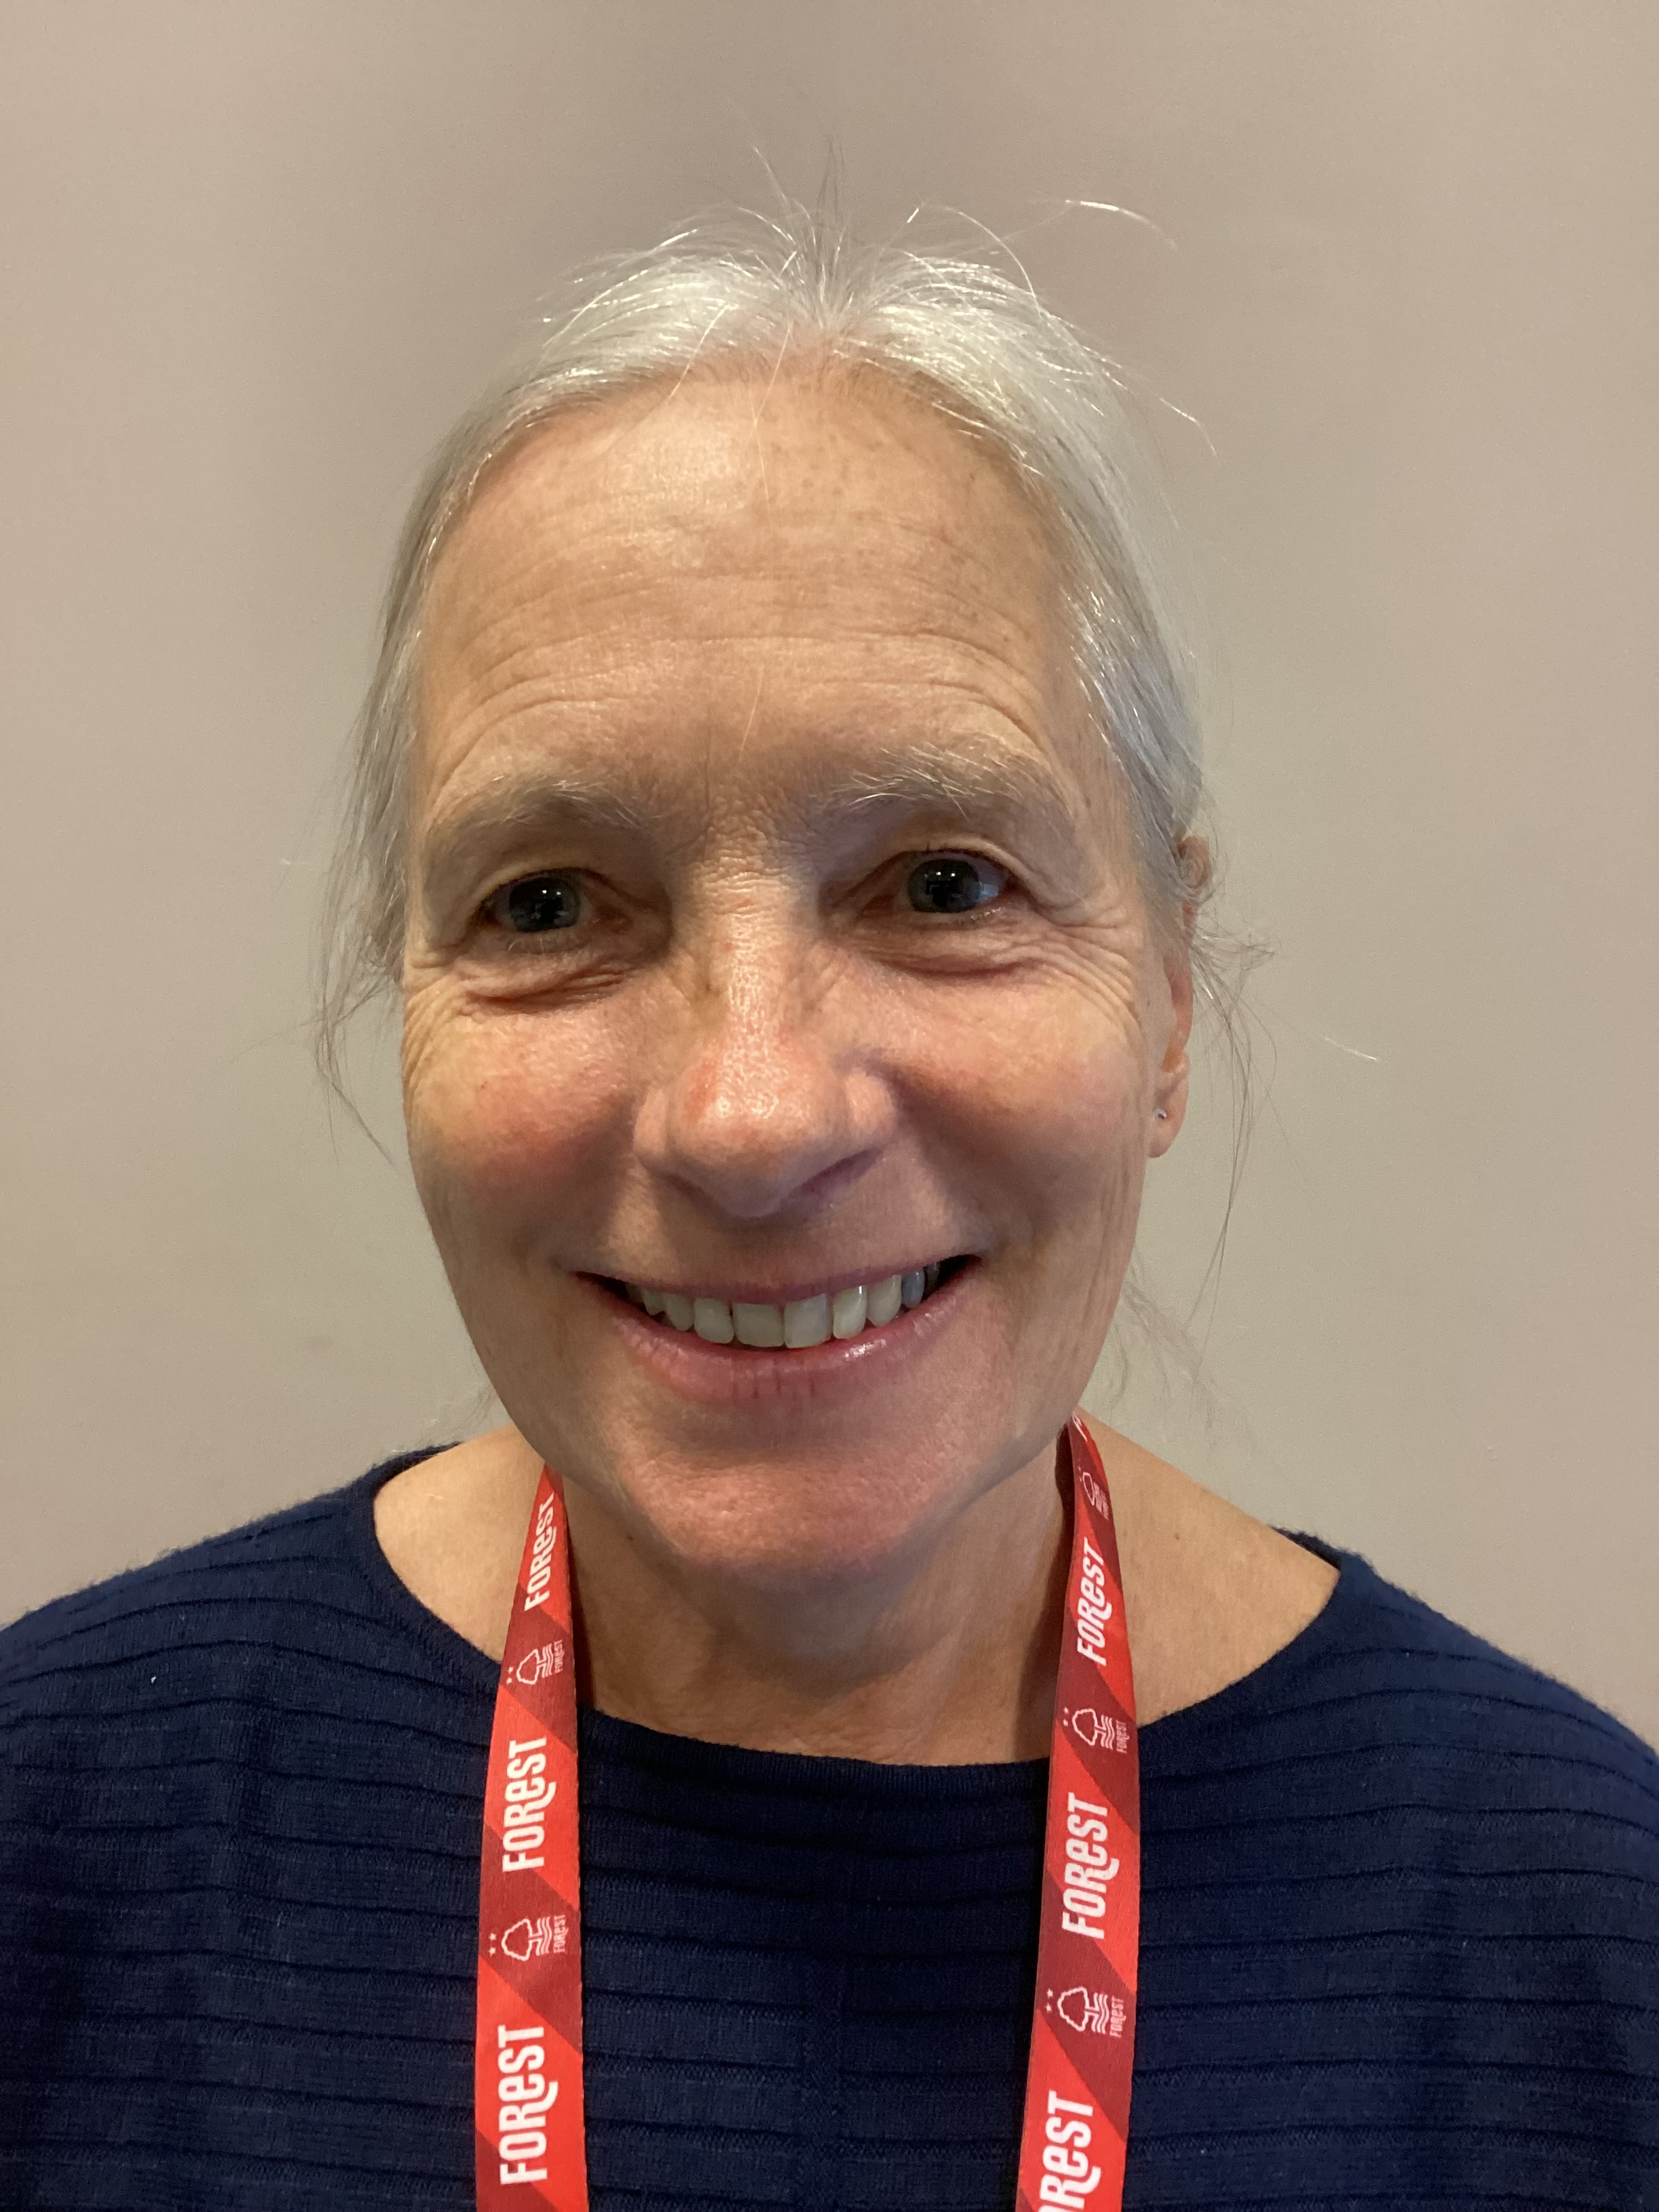

Staffing
Mrs Lowings
Cotgrave C of E Primary School
Miss Wilcox
Class 2 Teacher
Teaching Assistant

Slide 5
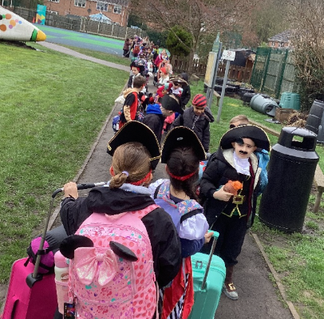
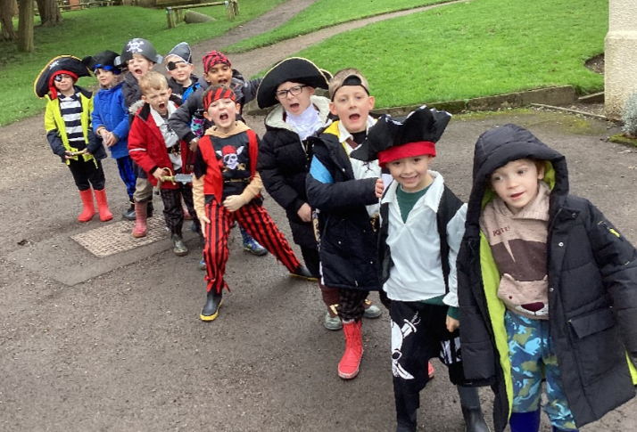
Pirate Theme
If your child would like to dress up like a pirate then please do!

Slide 6
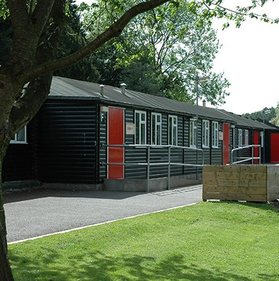
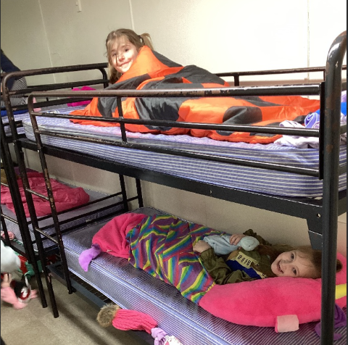
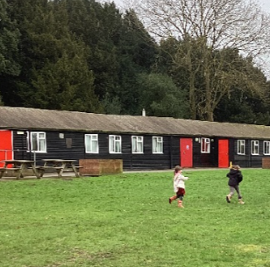
Accommodation
We will sleep in cabins that are equipped with central heating. The children will sleep in bunk beds – they will need a sleeping bag and pillow. A wheelie suitcase is essential because there is quite a walk from the coach stop to the cabins.

Slide 7
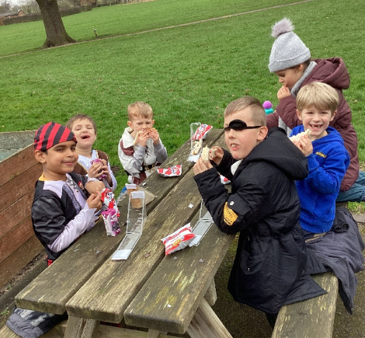
Meals
Lunches are picnics – sandwich, fruit and snacks.
The evening meal and breakfast are served in the Great Hall.
It is a hot buffet where the children go up and choose an option they would like.
There is a vegetarian option and they cater for all dietary requirements.
It is delicious!

Slide 8
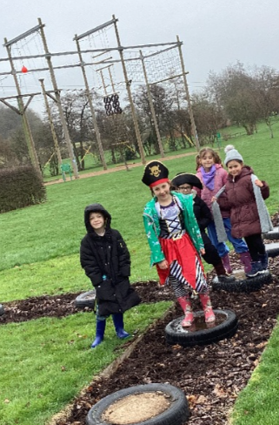
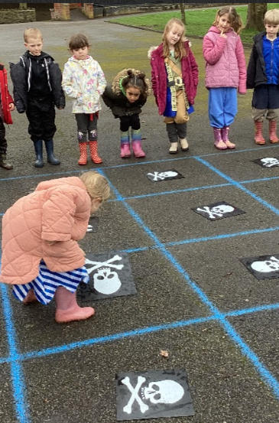
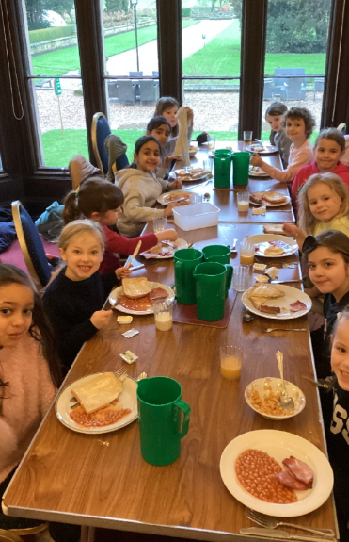
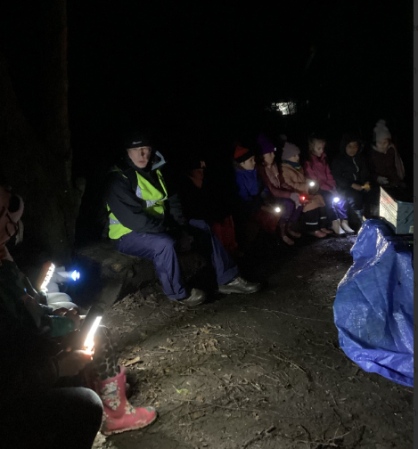
Day One
A night walk with teddies and torches then songs around the campfire!
Pirate Team Games
Dinner in the Great Hall
Pirate Treasure Trail

Slide 9
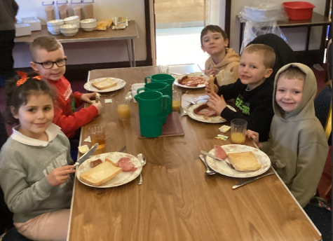
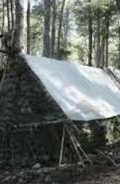

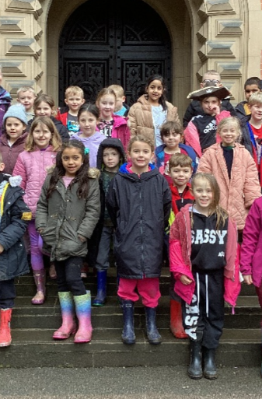
Day Two
Breakfast in the Great Hall
Outdoor Activities – Robin Hood theme
Back to school – ready for home time and sleep!
Outdoor Activities – Robin Hood theme

Slide 10
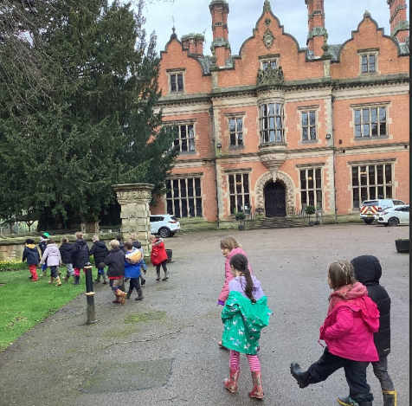
Any Questions?
Please come and chat to us if you have any worries or concerns.

