Slide 2
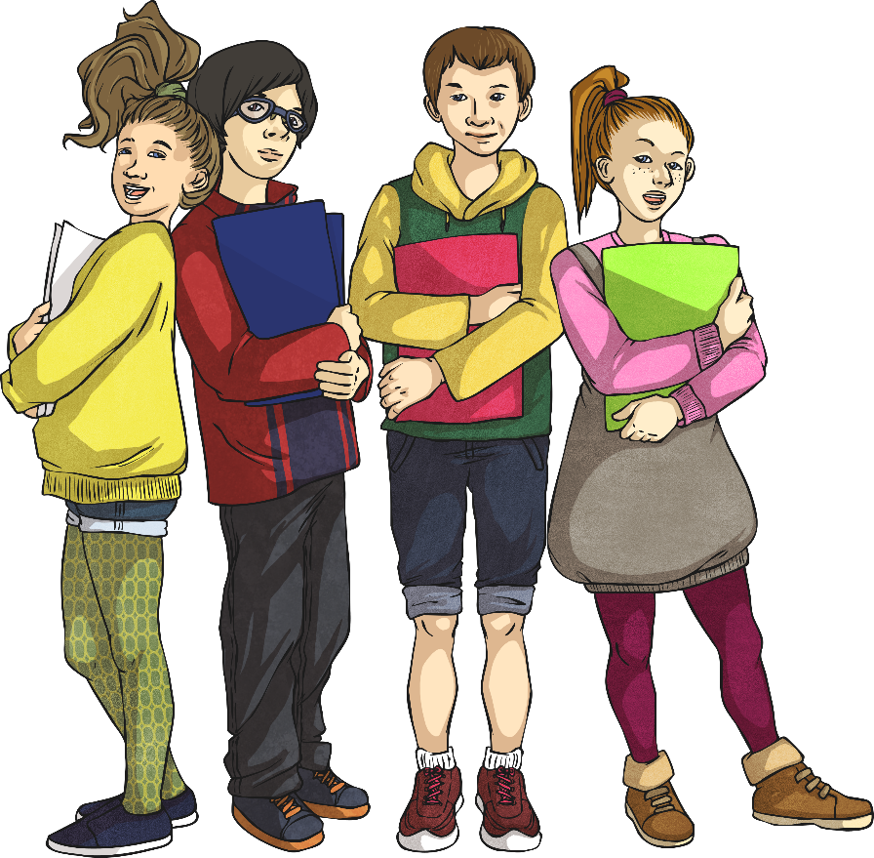
Week 1 Day 1
Week 1 Day 2
Week 1 Day 3
Week 1 Day 4
Week 1 Day 5

Slide 3
Menu
Week 1 Day 1
Fluency
Complete these questions.
Problem Solving
Write the three missing digits to make this addition correct.
1. 847 - 100 =
2. = 375 + 789
3. 85 ÷ 5 =
4. 37 × 6 =
5. 383.49 – 74.84 =
6. 0.8 ÷ 10 =
747
Reveal answer
3
8
 | 1
4 |  | 4
7 | 9 | 2
1164
Reveal answer
+
7
Reveal answer
17
Reveal answer
222
Reveal answer
Reasoning
308.65
15 × 6.1 = 91.5
Prove it!
Reveal answer
0.08
Reveal answer

Slide 4
Menu
Week 1 Day 2
Fluency
Complete these questions.
Problem Solving
What is the difference between people who liked cats the most and dogs the most?
1. 827 ÷ 1 =
2. = 462 - 284
3. 144 ÷ 9 =
4. 27 × 36 =
5. 384.48 + 85.47 =
6. 1.08 × 10 =
827
Reveal answer
9391
Reveal answer
Animal | Frequency
Dog | 37 483
Rabbit | 8727
Cat | 28 092
Hamster | 24 984
178
Reveal answer
16
Reveal answer
972
Reveal answer
Reasoning
469.95
457 924 406
Which is the odd one out? Give your reasoning.
Reveal answer
10.8
Reveal answer

Slide 5
Menu
Week 1 Day 3
Fluency
Complete these questions.
Problem Solving
Write the two missing value to make these equivalent fractions correct.
407
1. 407 × 1 =
2. = 48 × 36
3. 486 ÷ 3 =
4. 100 × 638 =
5. 5 – 1.15 =
6. 1320 ÷ 12 =
Reveal answer
Reveal answer
1728
4
12
18
Reveal answer
=
=
8
24
36
162
Reveal answer
63 800
Reveal answer
Reasoning
3.85
Reveal answer
Nikita says, “Adding two odd numbers always makes an even number. “
Is she correct? Explain your reasoning.
110
Reveal answer

Slide 6
Menu
Week 1 Day 4
Fluency
Complete these questions.
Problem Solving
3 pencils and a ruler cost £2.60
2 pencils cost £1.50.
What is the cost of 1 ruler?
1. 74 473 + 19 054 =
2. = 264 ÷ 11
3. 85 × 5 =
4. 37.5 – 12.35 =
383.4 × 0 =
6. 96 ÷ 4 =
93 527
Reveal answer
24
Reveal answer
35p
Reveal answer
425
Reveal answer
Reasoning
25.15
Reveal answer
Pavel writes the number 31 097 in words:
Explain the mistakes and any common misconceptions.
0
Reveal answer
Three thousand one hundred and ninety-seven
24
Reveal answer

Slide 7
Menu
Week 1 Day 5
Fluency
Complete these questions.
Problem Solving
A bag contains 1.2kg of flour.
Everyday George wants to use 50g to make pancakes.
How many days will the bag of flour last?
50 × 30 =
8.004 + 3.15 =
483 ÷ 3 =
383.49 – 74.84 =
83 ÷ 100 =
1500
Reveal answer
33 245
= 34 034 -789
Reveal answer
24 days
Reveal answer
11.154
Reveal answer
Reasoning
161
Reveal answer
Nikita compares the two numbers:
723 405 > 723 045
Identify and explain which digits Nikita has used to make this comparison.
308.65
Reveal answer
0.83
Reveal answer

