Slide 2
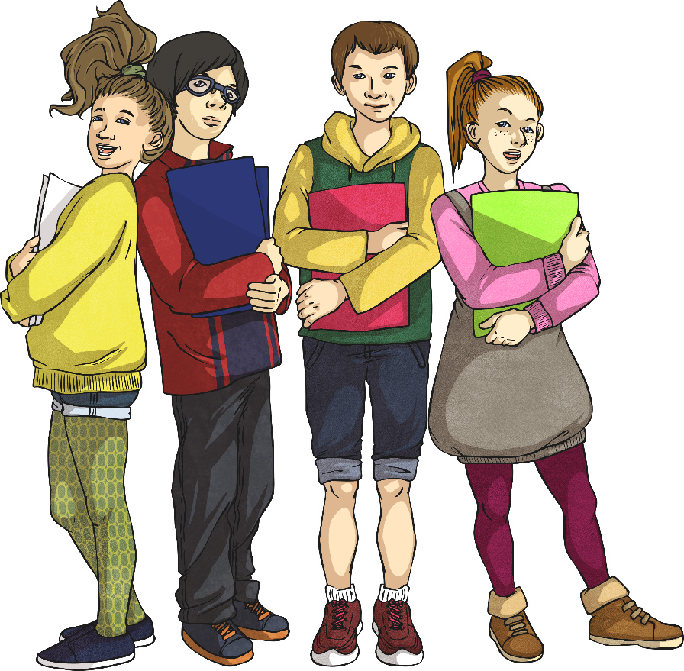
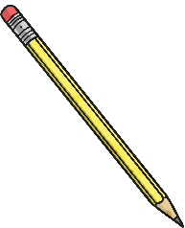

Week 2 Day 1
Week 2 Day 2
Week 2 Day 3
Week 2 Day 4
Week 2 Day 5

Slide 3

Menu
Week 2 Day 1
Fluency
Problem Solving
Complete these questions.
3n + 17 = 80
What is the value of n?
31 024
1. 39 497 - 8473 =
= 78 ÷ 3
3. 4² + 27 =
4. 247 × 45 =
5. 120.09 - 60.84 =
6. 11.8 × 1 =
Reveal answer
21
26
Reveal answer
Reveal answer
43
Reveal answer
11 115
Reveal answer
Reasoning
59.25
Reveal answer
45.094 + 3.91 = 49.004
Prove it!
11.8
Reveal answer

Slide 4
Menu
Week 2 Day 2
Fluency
Complete these questions.
Problem Solving
A tower of 20 cubes is 120mm tall.
Pavel takes off 4 cubes.
How tall is the tower now?
1. 30 043 - 1000 =
2. = 15 × 4.1
3. 725 ÷ 25 =
4. 37 232 + 12 925 =
5. 383.49 + 74.84 =
6. 1.042 × 10 =
29 043
Reveal answer
61.5
Reveal answer
96mm
Reveal answer
29
Reveal answer
50 157
Reveal answer
Reasoning
458.33
45.35 32.05 37.01
Which is the odd one out? Give your reasoning.
Reveal answer
10.42
Reveal answer

Slide 5
Menu
Week 2 Day 3
Fluency
Complete these questions.
Problem Solving
Write the three missing digits to make this subtraction correct.
1. 384 + 245 =
2. = 156 ÷ 6
3. 15% of 340 =
4. 100 × 634 =
5. 38 332 - 9375 =
6. 4 × 10 × 8 =
384 + 245 =
= 156 ÷ 6
3. 15% of 340 =
4. 100 × 634 =
5. 38 332 - 9375 =
6. 4 × 10 × 8 =
629
Reveal answer
26
Reveal answer
7
8
 | 1
4 |  | 4
2 | 4 | 4
-
7
Reveal answer
51
Reveal answer
63 400
Reveal answer
Reasoning
28 957
George has to explain how to round 4.95 to the nearest tenth. Use the blank number line to help George.
Reveal answer
320
Reveal answer

Slide 6
Menu
Week 2 Day 4
Fluency
Complete these questions.
Problem Solving
A study of 900 people found that 687 were right-handed, 174 were left-handed and the remainder were ambidextrous (could use either hand).
How many people were ambidextrous?
1384
1. 20% of 6920=
2.
3. 485 ÷ 5 =
4.
5. 9434 - 7484 =
6. ÷ 3 =
Reveal answer
2
or
7
3
4
1
= +
Reveal answer
5
5
5
5
97
Reveal answer
39 people
Reveal answer
2219
317 × 7 =
Reveal answer
Reasoning
1950
Reveal answer
Pavel says, “I can use 4 × 23 to multiply 0.04 × 23.”
Explain how Pavel could use 4 × 23 to multiply 0.04 × 23.
3
1
5
5
Reveal answer

Slide 7
Menu
Week 2 Day 5
Fluency
Complete these questions.
Problem Solving
Complete the sequence by filling in the missing numbers.
8437 - 1529 =
= 1 -
348 ÷ 29 =
429.09 + 55.56 =
57.8 ÷ 100 =
6908
Reveal answer
45
58 71 97
84
110
2
1
4
5
5
5
Reveal answer
Reveal answer
12
Reveal answer
Reasoning
Nikita draws this diagram to illustrate the multiplication of two fractions:
Explain which fractions are multiplied and how the diagram illustrates the multiplication.
307 × 61 =
18 727
Reveal answer
484.65
Reveal answer
0.578
Reveal answer

