Slide 2
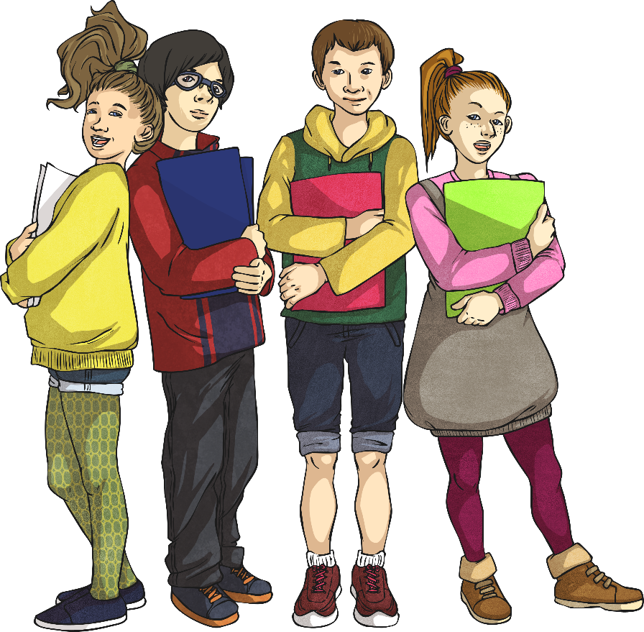
Week 3 Day 1
Week 3 Day 2
Week 3 Day 3
Week 3 Day 4
Week 3 Day 5

Slide 3
Menu
Week 3 Day 1
Fluency
Problem Solving
Complete these questions.
Each shape represents a number. What is the value of each shape?
3
1. × 150 =
2. = 100 - 54 ÷ 6
3. 80.5 - 5.05 =
4. 35 877 + 6685 =
5. 383.49 - 74.84 =
6. 15% × 340 =
5
90
Reveal answer
Circle = 35 Triangle = 12
91
Reveal answer
=59
Reveal answer
75.45
Reveal answer
=105
42 562
Reveal answer
Reasoning
308.65
Reveal answer
12% of 1150 = 138
Prove it!
51
Reveal answer

Slide 4
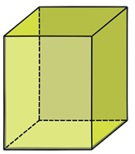
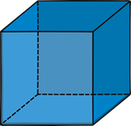
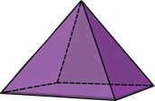
Menu
Week 3 Day 2
Fluency
Complete these questions.
Problem Solving
George pours 4l of juice into 3 containers.
He pours 694ml into the first container and 1.67l into the second container. How much juice does the third container have?
1. 70 + 1000 =
2. = +
3. 805 ÷ 1 =
4. 73 × 29 =
5. 2.7 – 1.65 =
6. 30 × 40 =
1070
Reveal answer
1
7
2
5
1
or
6
6
Reveal answer
6
6
1.636l or 1636ml
Reveal answer
805
Reveal answer
Reasoning
2117
Reveal answer
1.05
Reveal answer
1200
Reveal answer
Which is the odd one out?

Slide 5
Menu
Week 3 Day 3
Fluency
Complete these questions.
Problem Solving
Nikita is saving her money for a new bike costing £286. If she has already saved £39 and is then given £59 for her birthday, how much more does she need to save?
3924
1. 4924 - 1000 =
2. = 0.04 ÷ 10
3. 8 + 1 =
4. 37 + 6384 =
5. 4 - 1 =
6. 176 × 8 =
Reveal answer
0.004
Reveal answer
5
2
1
£188
10
Reveal answer
6
3
2
Reveal answer
Reasoning
6421
Reveal answer
Place these values in ascending order.
5.09 1.56 4.003 20.03
Explain your reasoning.
3
1
1
3
Reveal answer
4
2
4
1408
Reveal answer
1.56 4.003 5.09 20.03
Reveal answer

Slide 6
Menu
Week 3 Day 4
Fluency
Complete these questions.
Problem Solving
Pavel buys 4 pears. He pays with a £5 note. He receives £3.56. How much does 1 pear cost?
194.85
1. 85.47 + 109.38 =
2. = 340 - 60
3. 81 ÷ 9 =
4. 37 × 8 =
5. - =
6. 15.9 - (54 ÷ 6) =
Reveal answer
280
Reveal answer
£0.36 or 36p
Reveal answer
9
Reveal answer
296
Reveal answer
Reasoning
Explain how you multiply and divide decimal numbers, or numbers where the answer is a decimal, by 10.
65
48
17
100
100
100
Reveal answer
6.9
Reveal answer

Slide 7
Menu
Week 3 Day 5
Fluency
Complete these questions.
Problem Solving
At the beginning of the day, a grocer has 239 apples. He receives another 144 from his supplier and sells 307 during the day. How many apples does the grocer have at the end of the day?
581 ÷ 7 =
= 694 × 0
11 – 3.55 =
37 + (11 × 6) =
38.45 + 74.38 =
3808 × 27 =
83
Reveal answer
0
Reveal answer
7.45
Reveal answer
76 apples
Reveal answer
103
Reveal answer
Reasoning
112.83
Reveal answer
1
3
3
10
5
0.4
4
102 816
Reveal answer
Which is the odd one out?

