Slide 2

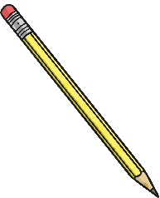

Week 4 Day 1
Week 4 Day 2
Week 4 Day 3
Week 4 Day 4
Week 4 Day 5

Slide 3

Menu
Week 4 Day 1
Fluency
Problem Solving
Complete these questions.
Write the two missing digits to make this multiplication correct.
3
5
498 - 100 =
= 375 + 789
3. 85 ÷ 5 =
4. 37 × 6 =
5. 383.49 – 74.84 =
6. 0.1 ÷ 10 =
398
Reveal answer
 |  | 5
 | × |  | 9
2 | 2 | 7 | 7
2
3
1164
Reveal answer
Reveal answer
17
Reveal answer
222
Reveal answer
Reasoning
308.65
Reveal answer
3
2
3
5
×
=
10
25
0.01
Reveal answer
Prove it!

Slide 4
Menu
Week 4 Day 2
Fluency
Complete these questions.
Problem Solving
A school order 12 boxes of paper. Each box contains 7 reams of paper. Each ream contains 110 sheets of paper. How many sheets of paper does the school order in total?
1. 84.7 – (5 × 12) =
2. = 4751 × 32
3. 855 ÷ 15 =
4.
5. 405 – 50.38 =
6. 7² + 83 =
24.7
Reveal answer
152 032
Reveal answer
9240 sheets
Reveal answer
57
Reveal answer
Reasoning
4
3
5
10
12
+ =
or
Reveal answer
6
6
12
354.62
Reveal answer
132
Reveal answer
Which is the odd one out?

Slide 5
Menu
Week 4 Day 3
Fluency
Complete these questions.
Problem Solving
Pavel chooses a number less than 40. He divides it by 2 and then adds 8. He then divides this result by 4. His answer is 6.5. What number did he
start with?
397
1. 487 - 90 =
2. = 3705 + 7289
3. 132 ÷ 11 =
4. 307 × 36 =
5. 435.7 - 76.48 =
6. 12.7 ÷ 100 =
Reveal answer
10 994
Reveal answer
36
12
Reveal answer
Reveal answer
Reasoning
11 052
Reveal answer
Place these values in ascending order.
5.09 1.56 4.003 20.03
Explain your reasoning.
359.22
Reveal answer
0.127
Reveal answer
1.56 4.003 5.09 20.03
Reveal answer

Slide 6

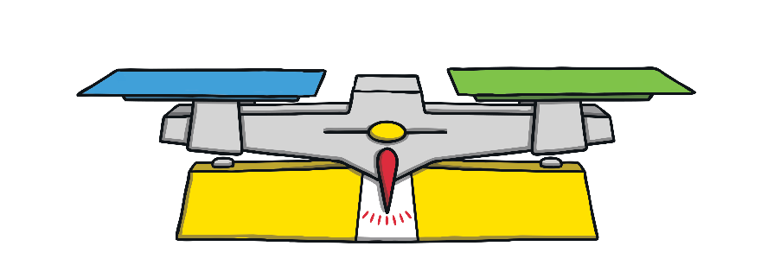




Menu
Week 4 Day 4
Fluency
Complete these questions.
Problem Solving
What is the mass of a wooden building block if a toy car weighs 26g?
7397
8407 - 1010 =
2. Box = 745 + 265
3. 144 ÷ 9 =
4. 82 × 4 =
5. 797 – 54.89 =
6. 7.5 ÷ 10 =
Reveal answer
Reveal answer
13g
1010
Reveal answer
16
Reveal answer
328
Reveal answer
Reasoning
George says, “When I compare unit fractions, I just look at the number at the bottom of the fraction, the denominator, and that tells me which is smaller.” Discuss with a partner how George is correct. Is there anything else he needs to say?
742.11
Reveal answer
0.75
Reveal answer

Slide 7
Menu
Week 4 Day 5
Fluency
Complete these questions.
Problem Solving
Fill in the missing digits.
9
2
1
2. = 25% × 1860
÷ 3 =
74 × 42 =
94.49 – 14.7 + 3.7 =
714 ÷ 17 =
20
- =
20
Reveal answer
5
0
8
1 35 + 3947 = 49 2
465
Reveal answer
Reveal answer
6
2
5
5
Reveal answer
Reasoning
3108
Reveal answer
Nikita says, “When I compare fractions with the same denominator, I look at the numerator.”
Discuss with a partner how Nikita is correct. Is there anything else she needs to say?
83.49
Reveal answer
42
Reveal answer

