Slide 2
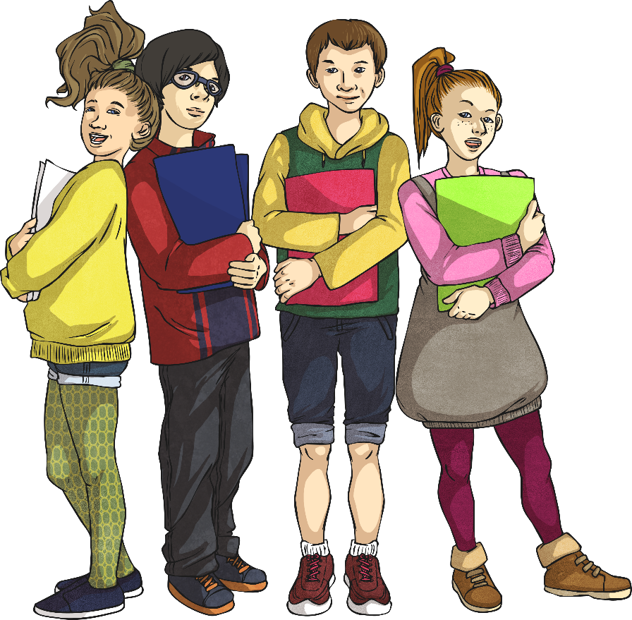
Week 5 Day 1
Week 5 Day 2
Week 5 Day 3
Week 5 Day 4
Week 5 Day 5

Slide 3
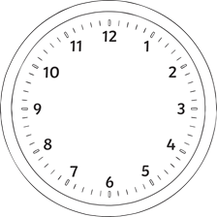
Menu
Week 5 Day 1
Fluency
Complete these questions.
Problem Solving
George leaves band practice at the time shown on the clock. His practice lasts 1 hour and 50 minutes. At what time does his practice start?
395
495 - 100 =
= 7 × 12
3. 350 ÷ 25 =
4. 708 × 60 =
5. 94 493 - 27 307 =
6. 11.8 + 8.083 =
Reveal answer
84
Reveal answer
14
Reveal answer
42 480
Reveal answer
12:55
Reveal answer
Reasoning
67 186
Reveal answer
10
1
÷ 5 =
Prove it!
20
10
19.883
Reveal answer

Slide 4
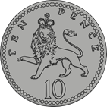
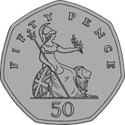
Menu
Week 5 Day 2
Fluency
Complete these questions.
Problem Solving
Pavel thinks of a number less than 35. He adds 9 to the number. Then he divides the number by 4 and uses the result to subtract 4.9. His answer is 5.1. What number did he start with?
1847
1. 847 + 1000 =
2. = 3.75 + 1.809
3. ÷ 5 =
4. × 6 =
5. 10 393 – 5736 =
6. 0.8 ÷ 1 =
Reveal answer
5.559
Reveal answer
15
3
31
20
20
Reveal answer
Reveal answer
3
2
4
Reasoning
Which is the odd one out?
7
7
Reveal answer
4657
Reveal answer
0.8
Reveal answer

Slide 5
Menu
Week 5 Day 3
Fluency
Complete these questions.
Problem Solving
Nikita had some money. She spent £1.50 on a fruit snack and £1.35 on a drink. She has six-eighths of her money left. How much money did Nikita have to start with?
1. 42 ÷ 1 =
2. = 0.04 ÷ 10
3. 82.5 + 45.65 =
4. 427 × 4 =
5. - =
6. × =
42
Reveal answer
0.004
Reveal answer
£11.40
Reveal answer
128.15
Reveal answer
Reasoning
16 more than -4 is -12.
True or false?
Explain your reasoning.
1708
Reveal answer
8
3
5
16
16
16
Reveal answer
4
3
2
6
5
5
Reveal answer

Slide 6
Menu
Week 5 Day 4
Fluency
Complete these questions.
Problem Solving
What is the value of a?
4a – 12 = 80
363
1. 372 - 9 =
2. = 37.55 + 7.89
3. 310 ÷ 5 =
4. 47 × 8 =
5. 38 349 - 17 484 =
6. 4.05 × 10 =
Reveal answer
45.44
a = 23
Reveal answer
Reveal answer
62
Reveal answer
Reasoning
The sum of 2 fractions is always greater than their product. Is this statement true?
Explain your reasoning.
376
Reveal answer
20 865
Reveal answer
40.5
Reveal answer

Slide 7
Menu
Week 5 Day 5
Fluency
Complete these questions.
Problem Solving
Write the three missing digits to make this addition correct.
74.7
1. 84.7 - 10 =
2. x = 3.75 + 78.9
3. 8400 ÷ 15 =
4. × 8 =
5. - =
6. 0.084 × 1000 =
Reveal answer
 | 3
2 |  | 5
9 | 1 | 9
6
4
+
8
82.65
Reveal answer
560
Reveal answer
Reveal answer
Reasoning
Pavel says that any net made of 6 squares can always be folded to make a cube. Do you agree?
Explain your reasoning.
3
3
3
7
7
Reveal answer
7
3
11
8
16
16
Reveal answer
84
Reveal answer

