Slide 1



SEN Staff Meeting
TUESDAY 28TH April
Interoception - The eighth sense

Slide 2

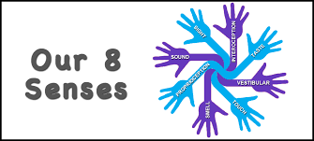
INTEROCEPTION: THE EIGHTH SENSORY SYSTEM
Sit back and close your eyes. What do you feel inside your body?
Is your heart beating fast or slow?
Are you breathing deeply or shallowly?
Do you have to go to the bathroom?
Are your muscles tense or loose?
How does your stomach feel?
Most of us are able to feel all of these sensations with the help of our little-known, but very important, eighth sensory system, Interoception.

Slide 3

How does interoception influence self-regulation?
When the interoceptive system is properly working, the sensations alert us that our internal balance is off and motivates us to take action, to do something that will restore the balance and help us feel more comfortable.
For example, if we feel thirsty – we get a drink; if we feel full – we stop eating; if we feel cold – we get a sweater; if we feel the need to urinate – we go to the bathroom; if we feel anxious – we seek comfort; if we feel frustrated—we seek help.
Interoception underlies our urge for action. If we feel that our internal balance is off, we are motivated to act, to seek immediate relief from the discomfort caused by the imbalance.

Slide 4

What do we know about Interoception and Autism?
As with other sensory systems, the interoceptive system can be impacted in individuals with autism. To date, only two research studies have examined the interoceptive experience of individuals with autism*. Both have found the participants with autism to have significantly lower awareness of their interoceptive signals. Although a great deal more research is needed in order to have a full understanding, these two studies confirm the numerous personal experiences reported by individuals with autism.

Slide 5
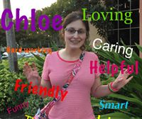
Chloe Rothschild, a 22-year old with autism
“I did not realize I had trouble feeling my internal body signals, as I had never heard of interoception before November 2014, but when I did, everything started to make sense. That is, difficulties with interoception help to clarify why I have such a hard time pinpointing my symptoms when I am not feeling well, why sometimes I seem to eat snack after snack without feeling full and why I get upset/anxious/overwhelmed so quickly, because I don’t feel it until I’m already far into the storm of the discomfort and frustration.”

Slide 6
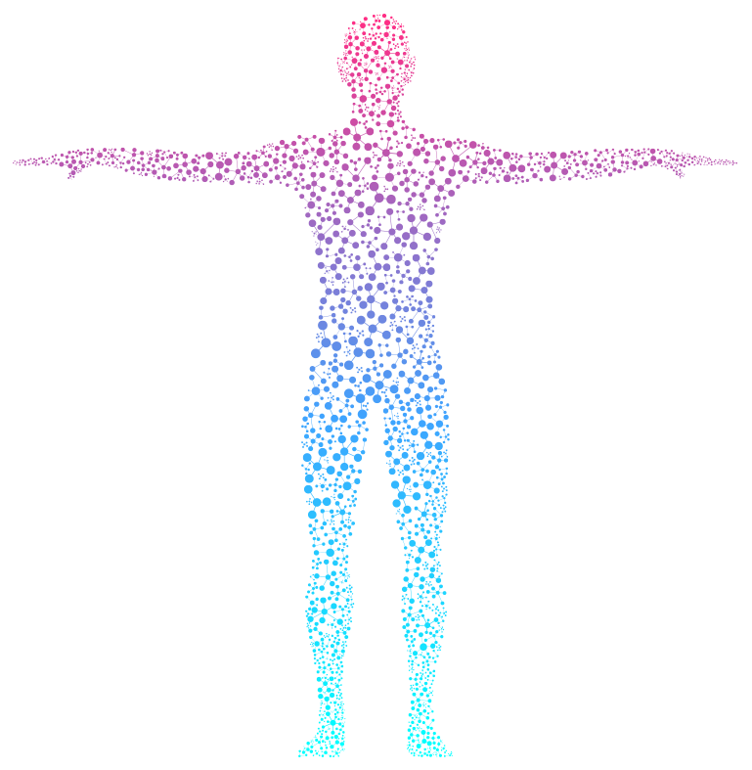
Hollis, an 18-year old with autism
“I went and got a plate of food thinking that I was hungry. I wasn’t hungry. I was bored. My body was not giving me clear signals, so I did not know what I was feeling. There have been many instances of this growing up. After learning about interoception, I started working on feeling my heart beat. I would lie in bed every night with my hand on my heart. It took about six months for me to feel my heart beat consistently. Interoception has been an important concept for my personal development as a teen with HF-ASD. Being able to receive clear internal signals has allowed me to be more successful in all areas of my life.”

Slide 7
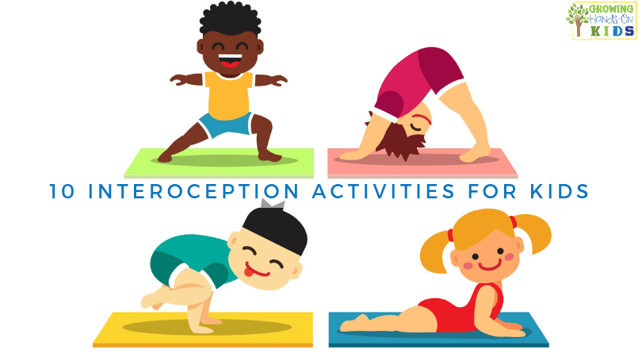
IMPROVING INTEROCEPTION
Improving interoception is good for all of us! The key is to take the time during daily activities to pay attention to our body signals. Many times, it can easier to notice a body signal when participating in an activity that evokes a strong sensation. For example, it can be easier to notice how your heart feels during active play/exercise or how your mouth feels when sipping a cold drink. The following list provides sample daily activities that may evoke stronger body signals within 15 diff erent body parts. These activities can serve as an opportunity to pay attention to the corresponding body part and notice how it feels. The more practice the better! Enjoy and have fun!

Slide 8
hANDS
Going outside in hot/ cold weather
Eating finger foods
Playing with clay, playdough
Clapping Playing in snow, rain
Washing hands
Hanging on monkey bars
Climbing on playground equipment
Doing a cartwheel or handstand
Writing name on paper
Typing Washing dishes
Holding a warm/cold drink
Catching a ball
Carrying a heavy load
Putting on hand lotion

Slide 9
FEET
In the bath/ shower
Walking/ resting feet on carpet
Walking/ resting feet in grass
Walking on a balance beam
Standing on one foot
Kicking a Ball
Jumping on a trampoline
Climbing on playground equipment
Going outside in hot/ cold weather
Relaxing on the couch or chair
Putting on socks/ shoes
Taking off sock/shoes
During a foot tickle
While running or active play
Carrying a heavy load
Putting lotion on feet

Slide 10
mOUTH
Brushing teeth
Taking a sip of ice water
Taking a sip of warm tea
Eating a mint
Gargling with mouthwash
Chewing gum
Blowing bubbles
Blowing up a balloon
Eating a crunchy snack
Eating soup
Eating a chewy snack
Putting on Chapstick
Eating a popsicle
Humming a song
Wiping with napkin
Sucking an ice cube

Slide 11
eYES
Reading a book
Stepping into sunshine
At bedtime/ naptime
Wearing sunglasses
Watching a movie
In a crowded place
Underwater swimming
Watching bubbles float
Catching fireflies
Eating soup
When waking up
Looking for cloud animals
Looking at favorite item
In a dark room
In a bright room
Catching a ball

Slide 12
ears
In a movie theatre
During a thunder storm
After a loud sound
Wearing headphones
Watching TV
In a crowded place
Underwater In the Shower
Someone whispering to me
Listening to rain
Listening to birds
Playing name that sound
Listening to favorite song
In a quiet room
In cold/hot weather
After listening to directions

Slide 13
NOSE
In a movie theater
Making a funny face
While dinner is cooking
Taking deep breath
Watching TV
Breathing in cold air
In hot weather
After running
In a restaurant Laughing During an illness
Smelling perfume
Blowing nose
Hanging upside down
In cold weather Swimming

Slide 14
vOICE
Answering a question
In a movie theater
Singing favorite song
During tickle time
Copying a character’s voice
Saying hi to someone far away
Repeating favorite lines from movies
After running
Saying something into a pillow or blanket
In a library Telling a secret
Right before bed
Saying hi to someone nearby
During mealtime
Singing a favorite song
Playing on playground

Slide 15
CHEEKS
Blowing bubbles
Taking a shower/ bath
After active play/ exercise
Going outside in hot/ cold weather
Standing near a fire or heater
Shaving face
Smiling really big
Sucking on a straw
Holding breath
Standing in front of a fan
Blowing a whistle/ instrument
Making silly faces
Putting on face lotion
In a warm car
Chewing or eating
Washing face

Slide 16
sKIN
Hugging a loved one
Taking a shower/ bath
After active play/ exercise
Going outside in hot/ cold weather
Standing near a fire, heater or fan
Standing in sunshine
Playing in a sensory bin
In freezer section of store
During tickle time
Standing in front of a fan
During/ after Water play
After a cut, scrape, bruise
Putting on lotion
In a warm car
Reaching in refrigerator
Laying under lots of blankets

Slide 17
mUSCLES
Hugging a loved one
Taking a shower/ bath
After active play/ exercise
Going outside in the cold
Stretching Playing on playground
Carrying a heavy load
Running around
During tickle time
Getting a massage
Watching TV At bedtime Reading a book
In a warm car
In the freezer section at store
Laying under lots of blankets

Slide 18
lUNGS
Hugging a loved one
Driving in the car
After active play/ exercise
Going outside in the cold
After coughing
Playing on playground
Carrying a heavy load
Breathing with favorite toy on belly
During tickle time
Getting a massage
Watching TV At bedtime Reading a book
Blowing a whistle or instrument
Blowing Bubbles
Laying under lots of blankets

Slide 19
HEART
Hugging a loved one
Driving in the car
After active play/ exercise
Watching a scary movie
During silly time
Playing on playground
Carrying a heavy load
Climbing steps
During tickle time
Getting a massage
Watching TV At bedtime Reading a book
When waking up
During bath time
Laying under lots of blankets

Slide 20
bRAIN
Hugging a loved one
Doing homework
After active play/ exercise
When swinging/ spinning/ hanging at playground
During silly time
In a crowded place
In a noisy room
In a quiet place
During favorite activity
During a head massage
Watching TV
At bedtime/ wakeup
Reading a book
Doing a handstand/ cartwheel
During bath time
Laying under lots of blankets

Slide 21
STOMACH
Laying on stomach
After a meal At wake up
Swinging at playground
During silly time
During tickle time
Watching a suspenseful video
After running
Before a meal
Going somewhere new
Going down a slide
Wearing a seatbelt
During hiccups
After drinking a few big sips of water
Doing crunches or sit-ups
Going over bumps in the car

Slide 22
bLADDER
Laying on stomach
Before going to the bathroom
At wake up
During a long car ride
While peeing (please respect privacy)
Wearing a seatbelt
After going to the bathroom
Watching TV At bedtime
Doing crunches or sit-ups
5 minutes after drinking a few big sips of water
20 minutes after drinking a few big sips of water

